Slide 1

Data Structures
Lecture 5: Doubly-Linked Lists

Slide 2

Performance of Singly-Linked Lists
It is O(1) to insert a node after a referenced node.
It is O(1) to remove a node after a referenced node.
It is O(n) (on average) to insert a node before a referenced node.
It is O(n) (on average) to remove a node before a referenced node.

Slide 3
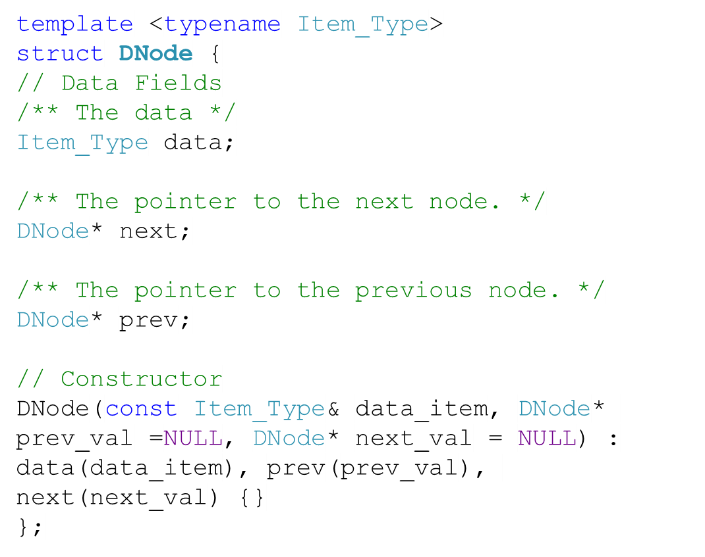
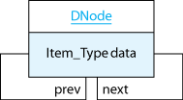
Doubly-Linked Lists

Slide 4
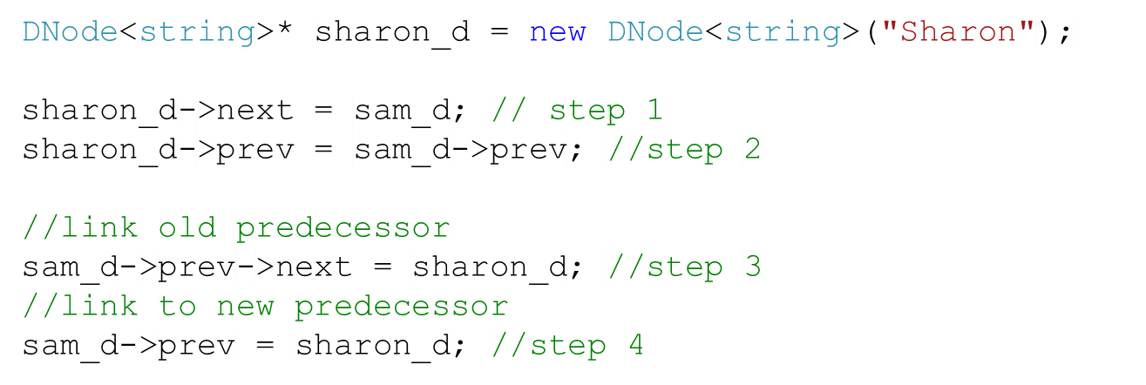

Inserting into a Doubly-Linked Lists (1)
We want to insert a node (“Sharon”) before node “Sam”
Step
4
DNode
Step
2
Step
1
next =
prev =
data=“Sharon”
Step
3
DNode
DNode
Can we shorten the code?
next =
prev =
data=“Harry”
next =
prev =
data=“Sam”
Steps 1 and 2 are interchangeable.
Steps 3 and 4 are not interchangeable. If step 4 precedes 3, we will lose the old predecessor.

Slide 5
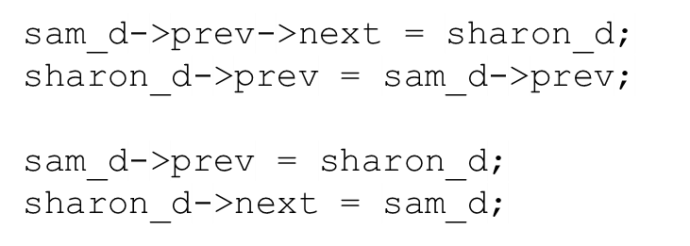
Inserting into a Doubly-Linked Lists (2)
Here is another way of doing it:
Step
3
DNode
Step
2
Step
4
next =
prev =
data=“Sharon”
Step
1
DNode
DNode
next =
prev =
data=“Harry”
next =
prev =
data=“Sam”
Not in the book

Slide 6
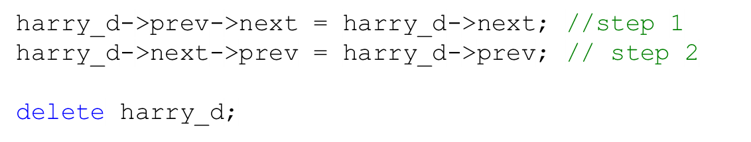
Removing from a Doubly-Linked List
We want to remove node “Harry”
Step
1
Steps 1 and 2 are interchangeable.
DNode
DNode
DNode
DNode
DNode
next =
prev =
data=“Tom”
next =
prev =
data=“John”
next =
prev =
data=“Harry”
next =
prev =
data=“Sharon”
next =
prev =
data=“Sam”
Step
2

Slide 7
Performance of Doubly-Linked Lists
It is O(1) to insert a node after a referenced node.
It is O(1) to remove a node after a referenced node.
It is O(1) to insert a node before a referenced node.
It is O(1) to remove a node before a referenced node.
The disadvantage of doubly-linked lists is the extra backward references and management that comes with them, compared to singly-linked lists.

Slide 8
Circular Lists
The head and tail are linked together.
tail
DNode
In a doubly-linked list:
head->prev = tail;
tail->next = head;
next =
prev =
data=“John”
head
DNode
DNode
In a singly-linked list:
tail->next = head;
next =
prev =
data=“Tom”
next =
prev =
data=“Harry”
Pros: You can continue to traverse the list after the last element.
DNode
next =
prev =
data=“Sam”
Cons: Risk of an infinite loop.

Slide 9

Task
Write a function finds out whether a list is circular. You have a reference to a random node from the list.
bool isCircular(DNode* start) {
DNode* current = start;
while(current!=NULL) {
current = current->next;
if(current==start)
return true;
}
return false;
}
DNode
next =
prev =
data=“John”
head
DNode
DNode
next =
prev =
data=“Tom”
next =
prev =
data=“Harry”
DNode
next =
prev =
data=“Harry”
Not in the book

Slide 10
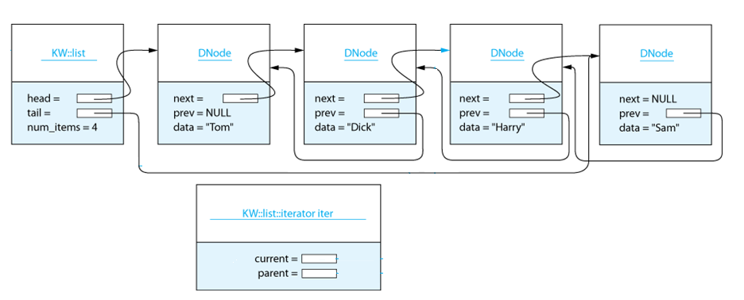
The Iterator
We can’t iterate through a list using the subscripting operator ( [] )
Iterators help us iterate through a list.
An iterator is like a moving place marker (cursor) that keeps track of the current position in the list.

Slide 11
The Iterator - Example
  // Access each list element and process it
  for (list<Item_Type>::iterator iter = a_list.begin();
  iter != a_list.end(); ++iter) {
  // Do something with next element (*iter)
  Item_Type next_element = *iter;
  . . .
  }

Slide 12
The Iterator Functions
Operator | Signature | Example
* | const Item_Type& operator* | Item_Type next_element = *iter;
* | Item_Type& operator* | *iter=new_value;
++ | iterator& operator++() | ++iter; //prefix
++ | iterator operator++(int) | iter++; //postfix
-- | iterator& operator--() | --iter; //prefix
-- | iterator operator--(int) | iter--; //postfix

Slide 13

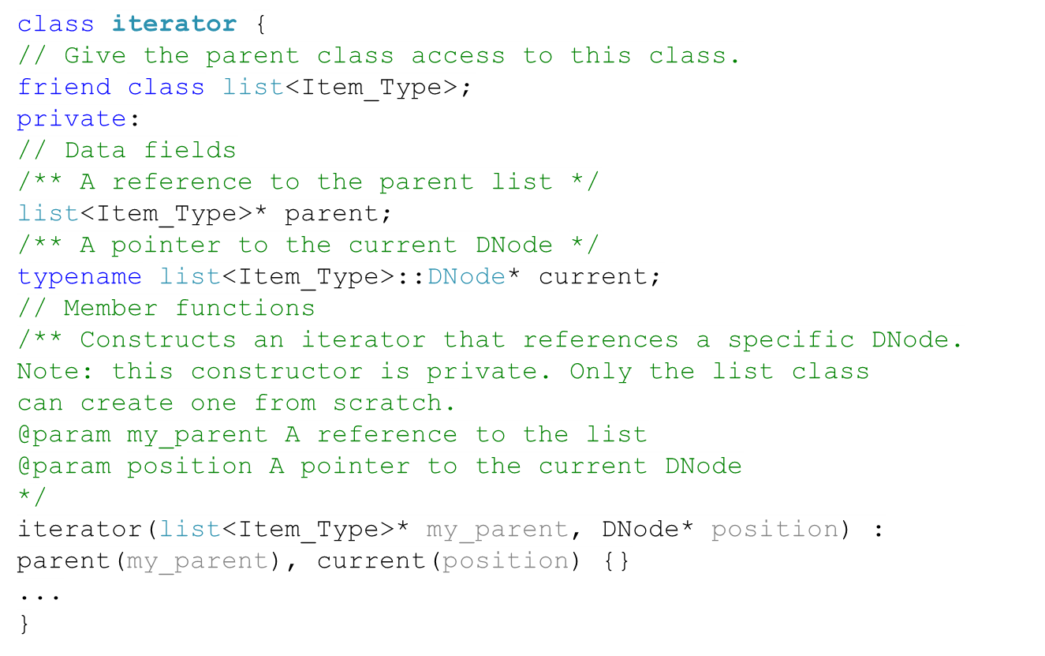
The iterator class

Slide 14
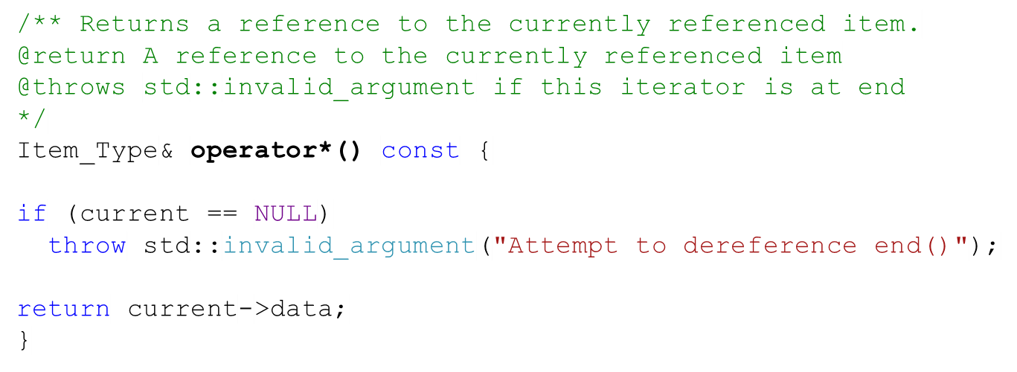
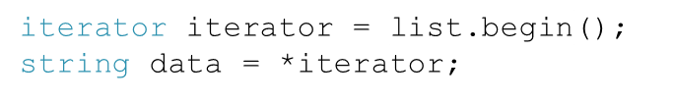
The * (dereferencing) operator
Verifies that the current pointer is valid.
Returns a reference to the data field in the node that it points to.
Example

Slide 15
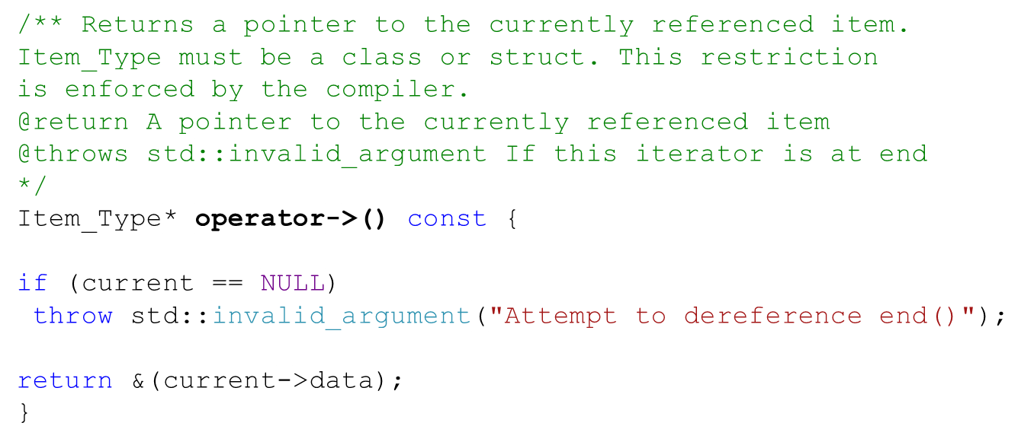
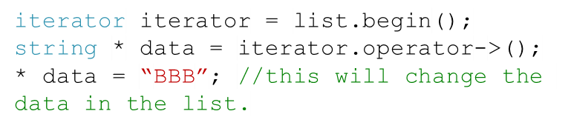
The -> (member access) operator
Verifies that the current pointer is valid.
Returns a pointer to the data field in the current node.
Example

Slide 16
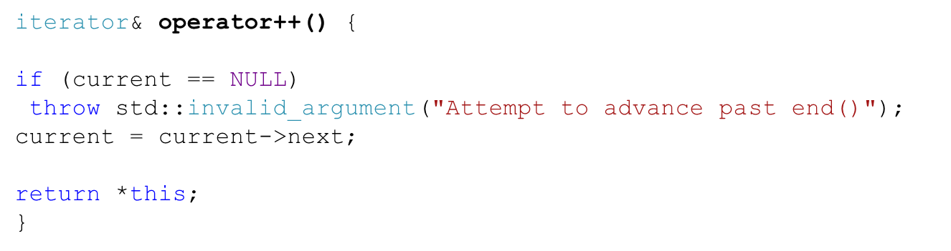
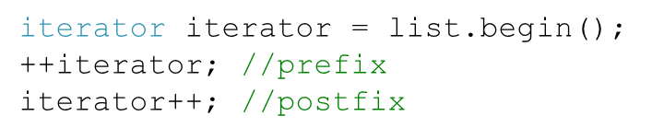
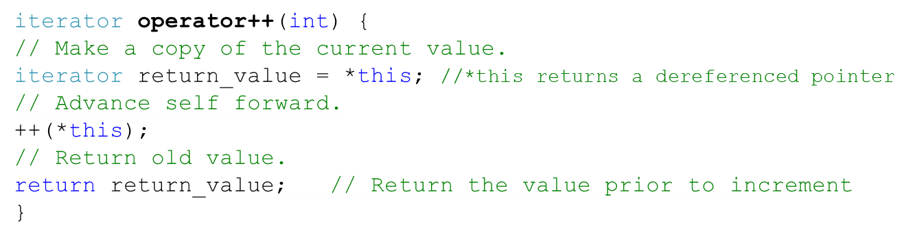
The ++ (increment) operator
Prefix
Example
Which operator performs better?
Postfix

Slide 17
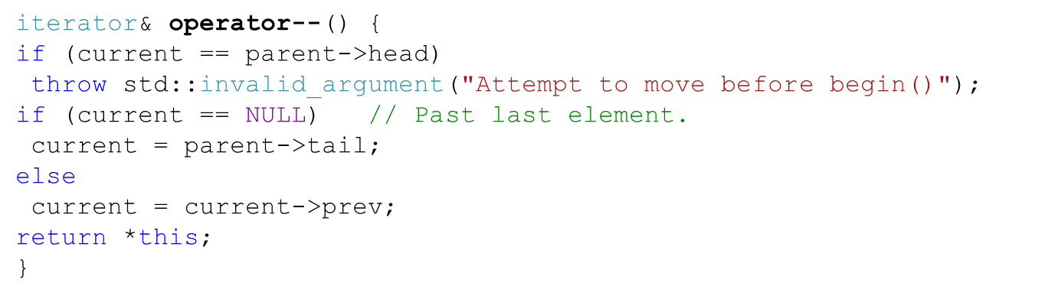
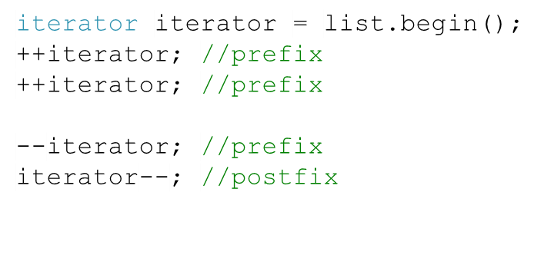
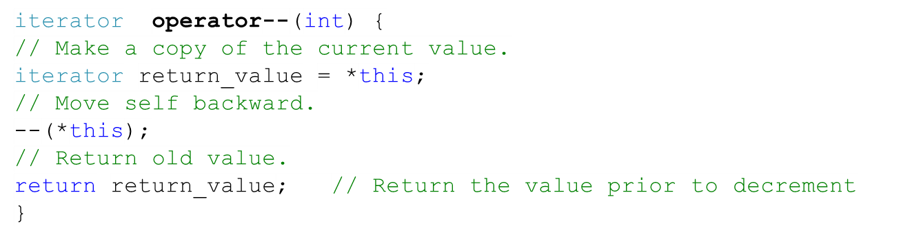
The -- (decrement) operator
Prefix
Example
Postfix

Slide 18
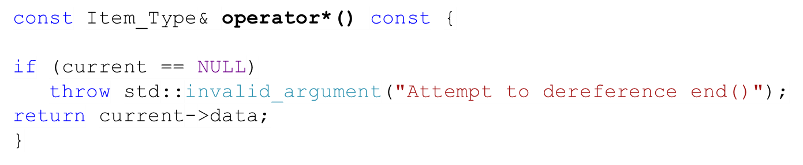
The const_iterator Class (1)
The const_iterator is identical to iterator, with two exceptions:
- The dereferencing operator returns a const reference.
- The member access operator returns a const pointer.
You need to use it when operating on a const list. In other words, you can use it when you are just reading a list (but not changing it)

Slide 19
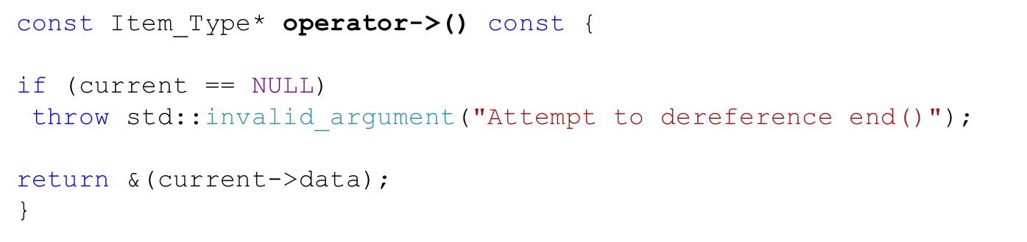
The const_iterator Class (2)
The const_iterator is identical to iterator, with two exceptions:
- The dereferencing operator returns a const reference.
- The member access operator returns a const pointer.
You need to use it when operating on a const list. In other words, you can use it when you are just reading a list (but not changing it)

Slide 20
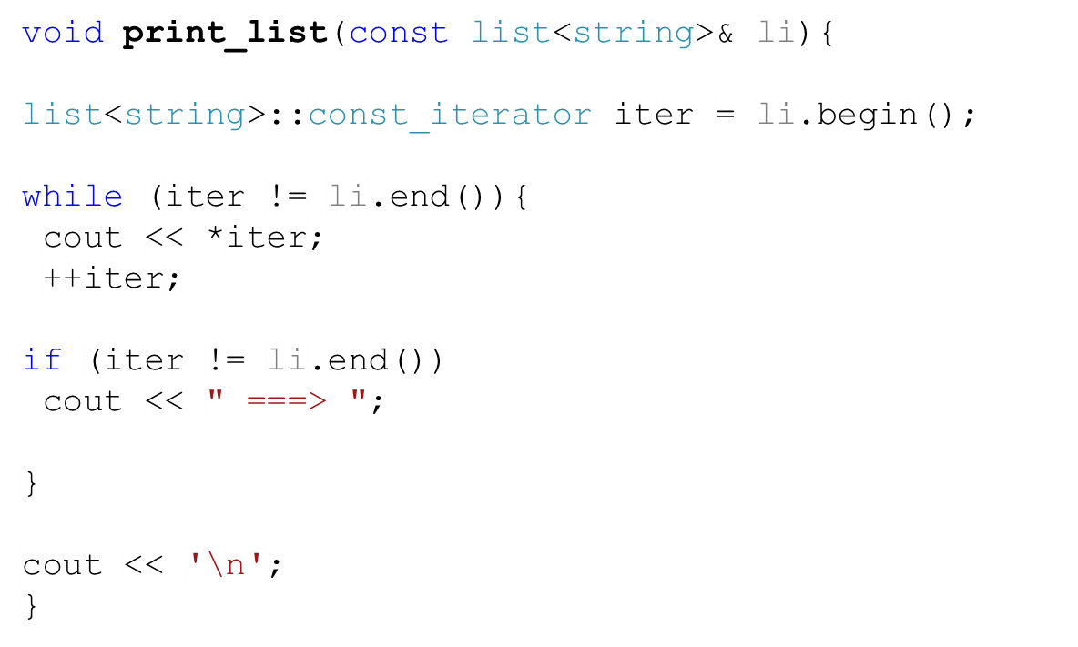
Example on Iterators (1)
We would like to print the data in a list
Notice that we used a constant iterator because we are operating on a constant list.

Slide 21
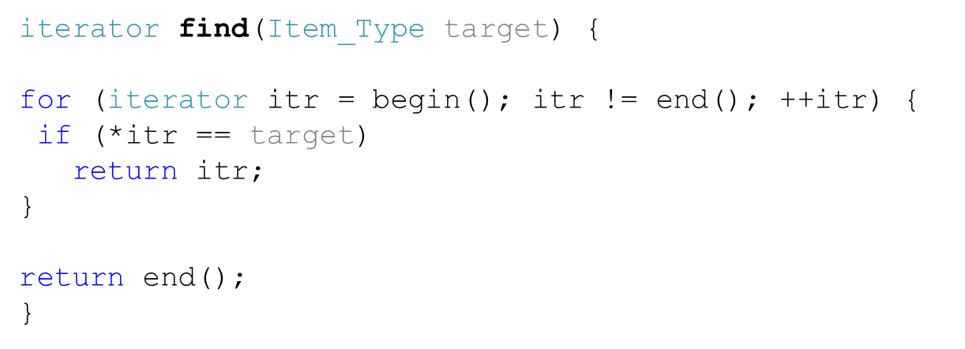
Example on Iterators (2)
We would like to find the first occurrence of an item

Slide 22
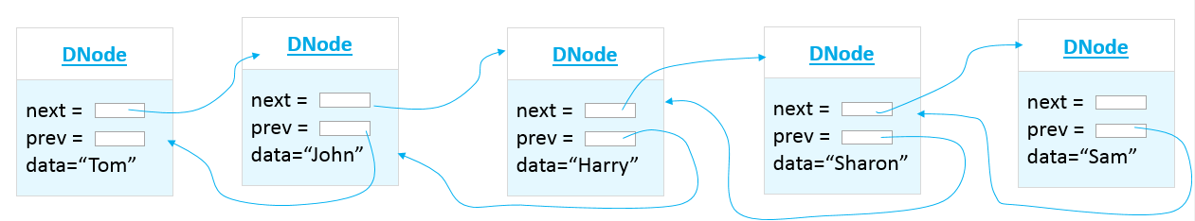
Task
Not in the book
Write a function that overloads the [] operator for the list class so that we can access and change an item with a given index. The head is the item with index 0. For instance, this is what these statements mean for the list below: string a = list[2]; //a = “Harry” list[2]=“Song”; // “Harry” now is changed to “Song” Use iterators, and assume that function is a member function of class list.
head

Slide 23
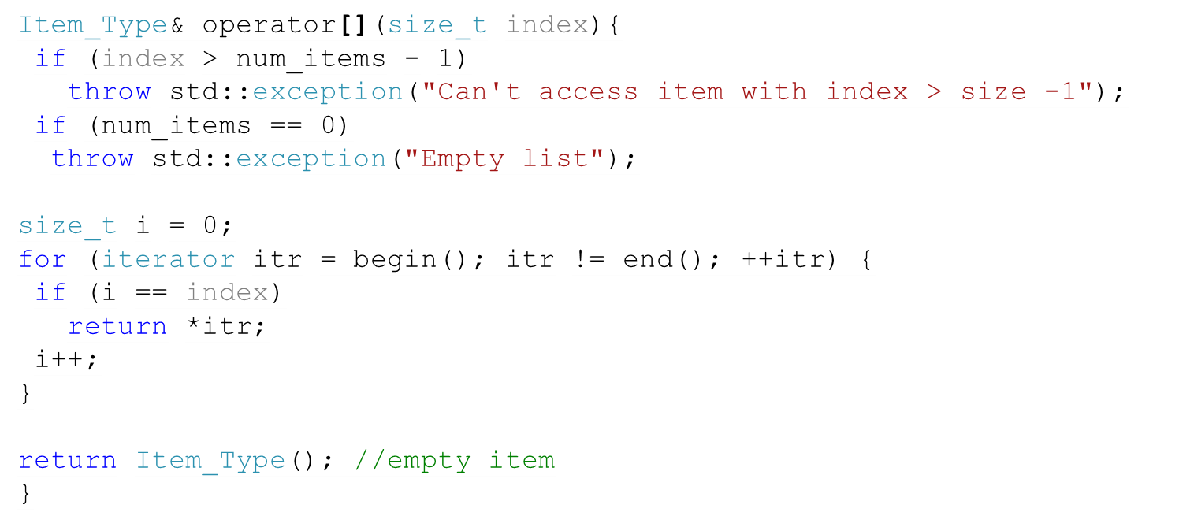
Solution
Not in the book
Would it make sense to iterate through a list with the [] operator?
head

Slide 24
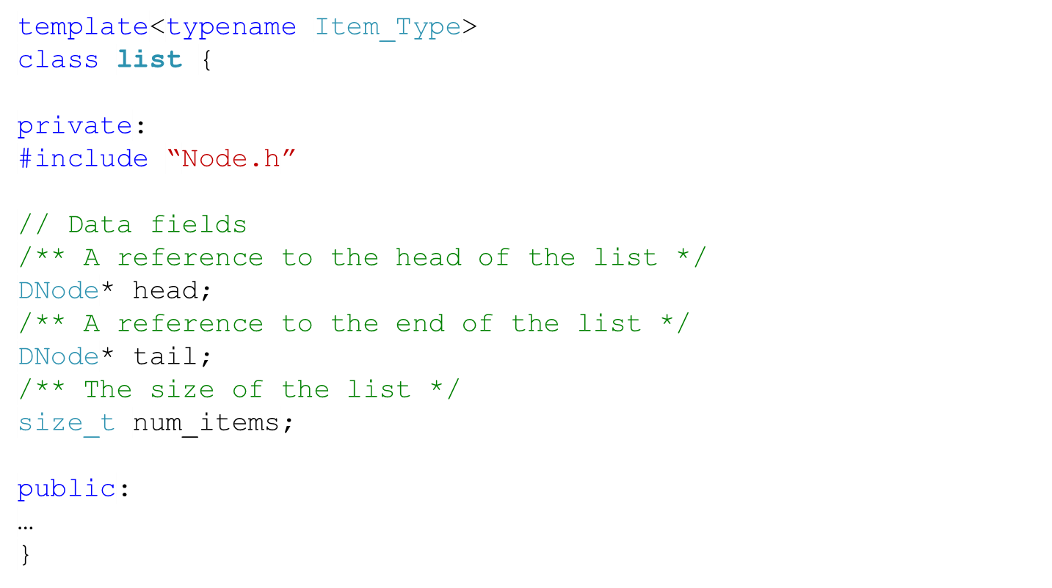
Implementation of a Doubly-Linked List

Slide 25


Functions of list class (1)
Function | Behavior
 | Inserts a copy of item into the list before position pos. Returns an iterator that references the newly inserted item.
 | Removes the item from the list at position pos. Returns an iterator that references the item following the one erased.
 | Removes all the occurrences of item from the list.
 | Inserts a copy of item as the first element of the list.
 | Adds a copy of item to the end of the list.
 | Removes the first item from the list.

Slide 26









Functions of list class (2)
Function | Behavior
 | Removes the last item from the list.
 | Gets the first element in the list. Both constant and modifiable versions are provided.
 | Gets the last element in the list. Both constant and modifiable versions are provided.
 | Returns an iterator that references the first item of the list.
 | Returns a const_iterator that references the first item of the list.
 | Returns an iterator that references the end of the list.
 | Returns a const_iterator that references the end of the list.

Slide 27



Functions of list class (3)
Function | Behavior
 | Exchanges the contents of this list with the other list.
 | Returns true if this list is empty.
 | Returns the number of items in the list.

Slide 28
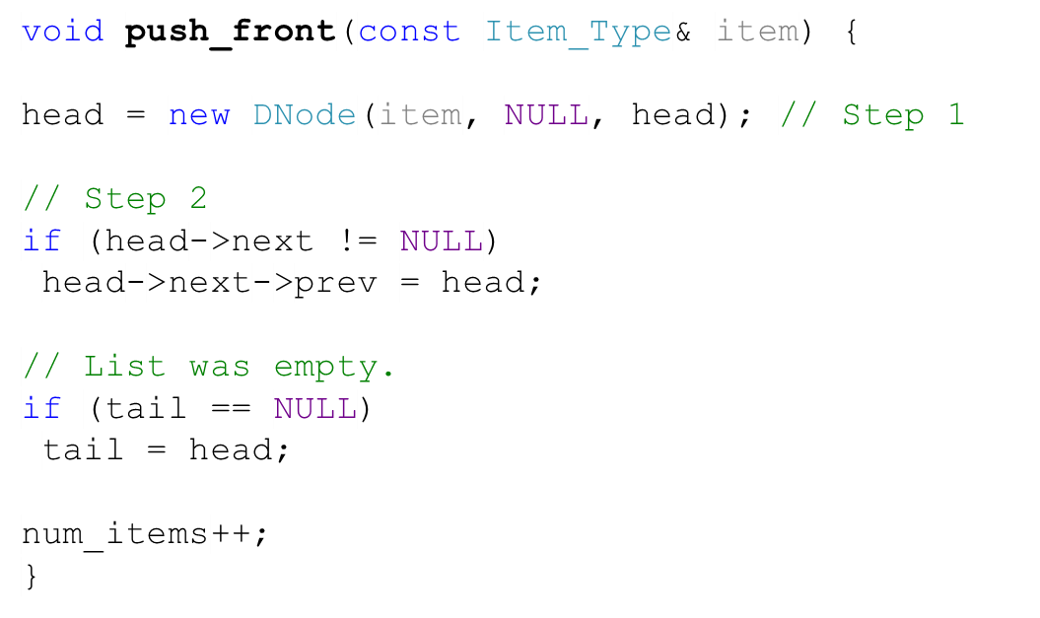
The push_front Function
DNode
Step
1
next =
prev =
data=“Ann”
list
DNode
DNode
DNode
head =
tail =
num_items = 3
Step
2
next =
prev =
data=“Tom”
next =
prev =
data=“John”
next =
prev =
data=“Harry”
4

Slide 29
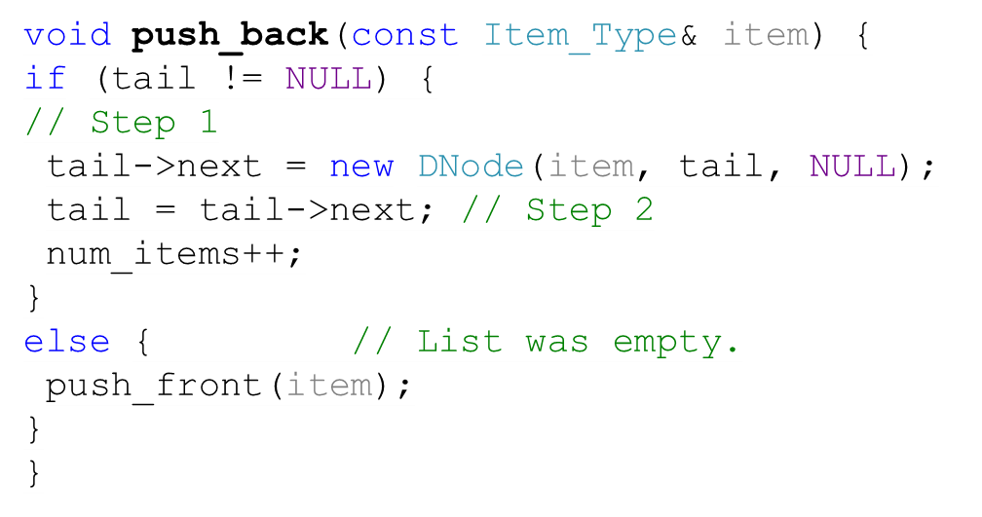
The push_back Function
DNode
Step
1
next =
prev =
data=“Harry”
list
DNode
DNode
DNode
head =
tail =
num_items = 3
next =
prev =
data=“Tom”
next =
prev =
data=“John”
next =
prev =
data=“Sam”
4
Step
2

Slide 30
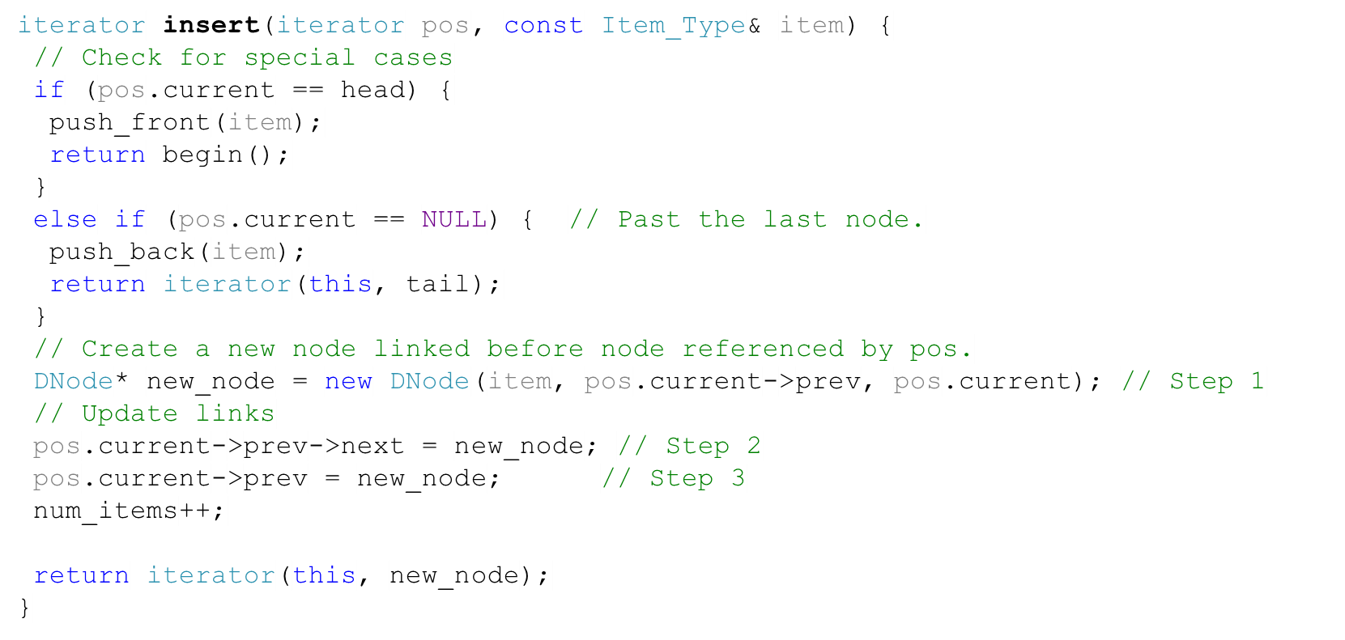
The insert Function
head
tail
NULL
NULL
head
tail
NULL
NULL
head
tail
NULL
NULL
head
tail
NULL
NULL
head
X
Y
tail
NULL
NULL
NULL
head
X
Y
tail
NULL

Slide 31
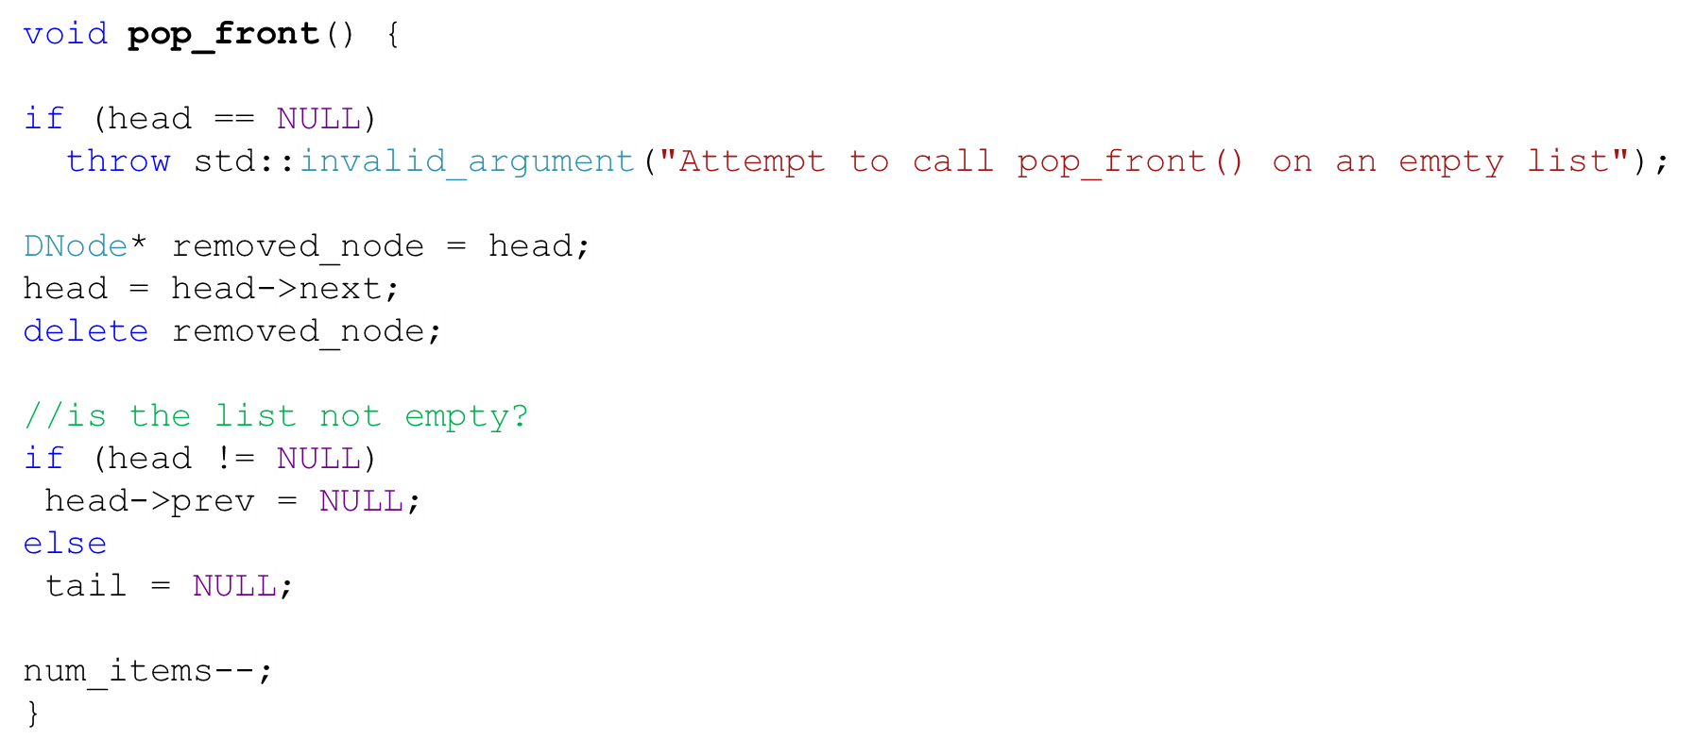
The pop_front Function
list
DNode
DNode
DNode
head =
tail =
num_items = 3
next =
prev =
data=“Tom”
next =
prev =
data=“John”
next =
prev =
data=“Harry”
2

Slide 32
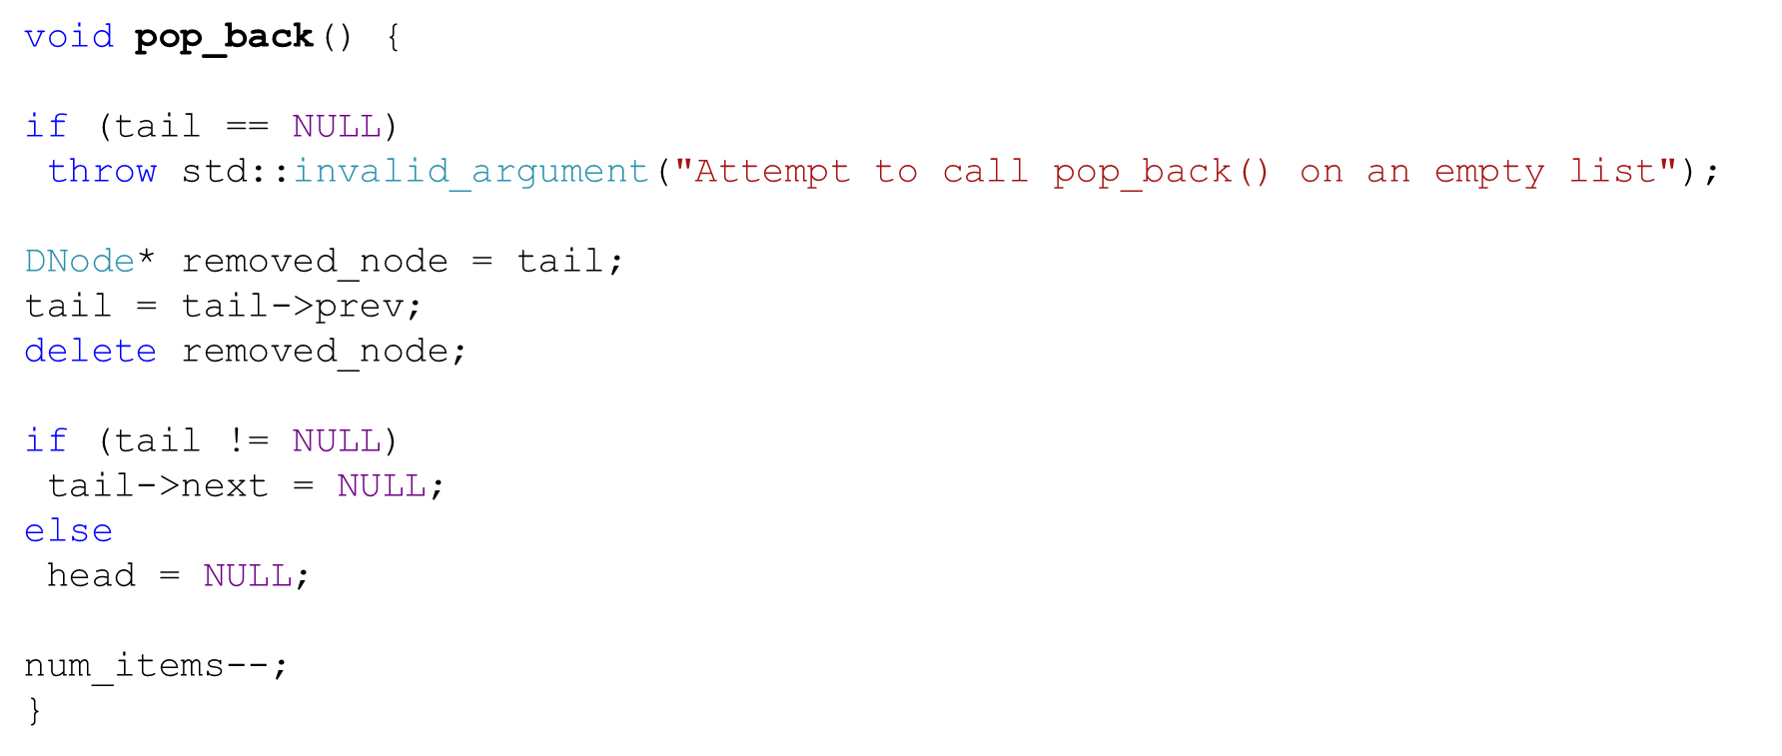
The pop_back Function
list
DNode
DNode
DNode
head =
tail =
num_items = 3
next =
prev =
data=“Tom”
next =
prev =
data=“John”
next =
prev =
data=“Harry”
2

Slide 33
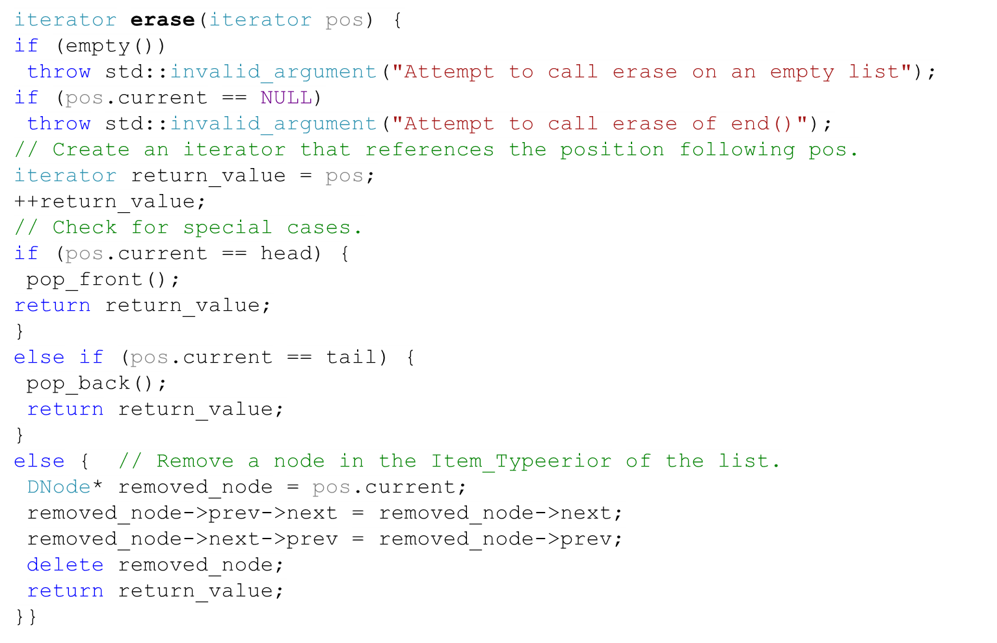
The erase Function
head
tail
NULL
NULL
head
tail
NULL
NULL
head
tail
NULL
NULL
head
tail
NULL
NULL

Slide 34
The erase Function
head
X
Y
Z
tail
NULL
NULL
head
X
Z
tail
NULL
NULL

Slide 35
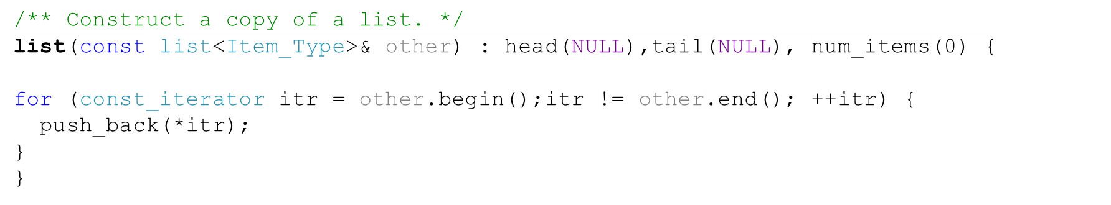
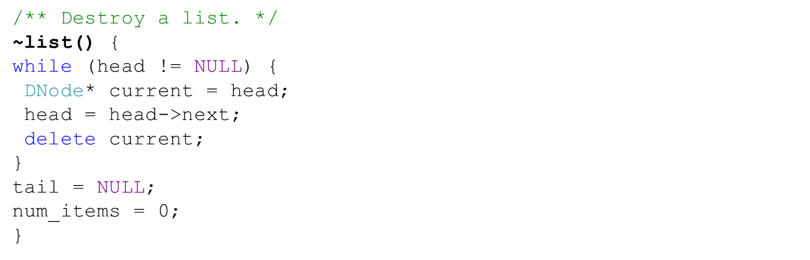
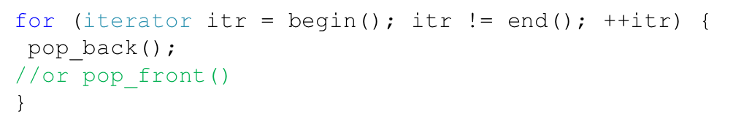
The list Copy Constructor and Destructor
Constructor
Question:
What’s wrong with writing the destructor in this way?
Destructor
Notes:
A->B->C->D->E
*
A->B->C->D A->B->C->D->E
*
A->B->C
*
A->B

Slide 36
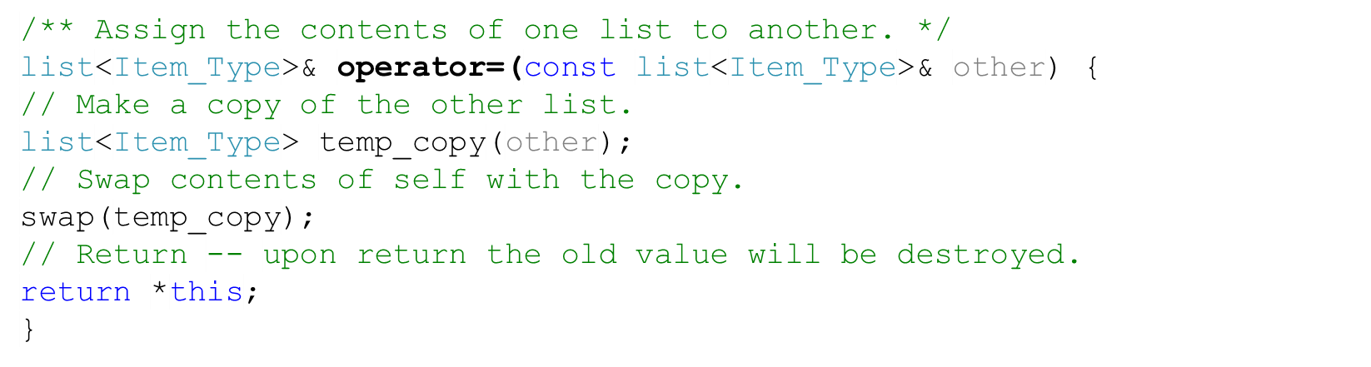
The list Assignment Operator

Slide 37

Task
Task
  ++pos_a;
  pos_a = a_list.insert(pos_a, “Jane”);
  ++pos_a;
  ++pos_a;
  pos_a = a_list.insert(pos_a, “Kim”);
  pos_a = a_list.erase(pos_a);
Describe the effect of the statements on the right. a_list (the list) and pos_a (the iterator) are shown in the figure below
list
DNode
DNode
DNode
DNode
head=
tail=
num_items= 4
Next=
Prev= NULL
Data=“Tom”
Next=
Prev=
Data=“John”
Next=
Prev=
Data=“Harry”
Next= NULL
Prev= Data=“Sam”
pos_a
current=
parent=

Slide 38
Task
Task Solution (1)
  ++pos_a;
  pos_a = a_list.insert(pos_a, “Jane”);
  ++pos_a;
  ++pos_a;
  pos_a = a_list.insert(pos_a, “Kim”);
  pos_a = a_list.erase(pos_a);
list
DNode
DNode
DNode
DNode
head=
tail=
num_items= 4
Next=
Prev= NULL
Data=“Tom”
Next=
Prev=
Data=“John”
Next=
Prev= Data=“Harry”
Next= NULL
Prev= Data=“Sam”
pos_a
current=
parent=

Slide 39
Task
Task Solution (2)
  ++pos_a;
  pos_a = a_list.insert(pos_a, “Jane”);
  ++pos_a;
  ++pos_a;
  pos_a = a_list.insert(pos_a, “Kim”);
  pos_a = a_list.erase(pos_a);
list
DNode
DNode
DNode
DNode
head=
tail=
num_items= 4
Next=
Prev= NULL
Data=“Tom”
Next=
Prev=
Data=“John”
Next=
Prev= Data=“Harry”
Next= NULL
Prev= Data=“Sam”
pos_a
current=
parent=

Slide 40
Task
Task Solution (3)
  ++pos_a;
  pos_a = a_list.insert(pos_a, “Jane”);
  ++pos_a;
  ++pos_a;
  pos_a = a_list.insert(pos_a, “Kim”);
  pos_a = a_list.erase(pos_a);
list
DNode
DNode
DNode
DNode
DNode
head=
tail=
num_items= 5
Next=
Prev= NULL
Data=“Tom”
Next=
Prev=
Data=“John”
Next=
Prev= Data=“Harry”
Next=
Prev= Data=“Jane”
Next= NULL
Prev= Data=“Sam”
pos_a
current=
parent=

Slide 41
Task
Task Solution (4)
  ++pos_a;
  pos_a = a_list.insert(pos_a, “Jane”);
  ++pos_a;
  ++pos_a;
  pos_a = a_list.insert(pos_a, “Kim”);
  pos_a = a_list.erase(pos_a);
list
DNode
DNode
DNode
DNode
DNode
head=
tail=
num_items= 5
Next=
Prev= NULL
Data=“Tom”
Next=
Prev=
Data=“John”
Next=
Prev= Data=“Harry”
Next=
Prev= Data=“Jane”
Next= NULL
Prev= Data=“Sam”
pos_a
current=
parent=

Slide 42
Task
Task Solution (5)
  ++pos_a;
  pos_a = a_list.insert(pos_a, “Jane”);
  ++pos_a;
  ++pos_a;
  pos_a = a_list.insert(pos_a, “Kim”);
  pos_a = a_list.erase(pos_a);
list
DNode
DNode
DNode
DNode
DNode
head=
tail=
num_items= 5
Next=
Prev= NULL
Data=“Tom”
Next=
Prev=
Data=“John”
Next=
Prev= Data=“Harry”
Next=
Prev= Data=“Jane”
Next= NULL
Prev= Data=“Sam”
pos_a
current=
parent=

Slide 43
Task
Task Solution (6)
  ++pos_a;
  pos_a = a_list.insert(pos_a, “Jane”);
  ++pos_a;
  ++pos_a;
  pos_a = a_list.insert(pos_a, “Kim”);
  pos_a = a_list.erase(pos_a);
list
DNode
DNode
DNode
DNode
DNode
DNode
head=
tail=
num_items= 6
Next=
Prev= NULL
Data=“Tom”
Next=
Prev=
Data=“John”
Next=
Prev= Data=“Harry”
Next=
Prev= Data=“Jane”
Next=
Prev= Data=“Sam”
Next= NULL
Prev= Data=“Kim”
pos_a
current=
parent=

Slide 44
Task
Task Solution (7)
  ++pos_a;
  a_list.insert(pos_a, “Jane”);
  ++pos_a;
  ++pos_a;
  a_list.insert(pos_a, “Kim”);
  a_list.erase(pos_a);
list
DNode
DNode
DNode
DNode
DNode
head=
tail=
num_items= 5
Next=
Prev= NULL
Data=“Tom”
Next=
Prev=
Data=“John”
Next=
Prev= Data=“Harry”
Next=
Prev= Data=“Jane”
Next= NULL
Prev= Data=“Sam”
pos_a
current=
parent=

Slide 45
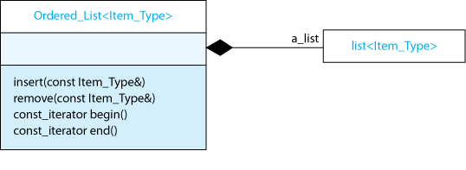
Ordered Lists (1)
We would like to implement a list that is ordered (e.g. alphabetically for instance) even after you insert and remove items from it.
We can either write a class that inherits the list class or uses it. Which approach should we go for?
If we inherit the list class, we allow users to use functions that might put the list out of order (e.g. push_front, pop_back).
1
1
The best solution is to write a class Ordered_List that uses the list class.

Slide 46
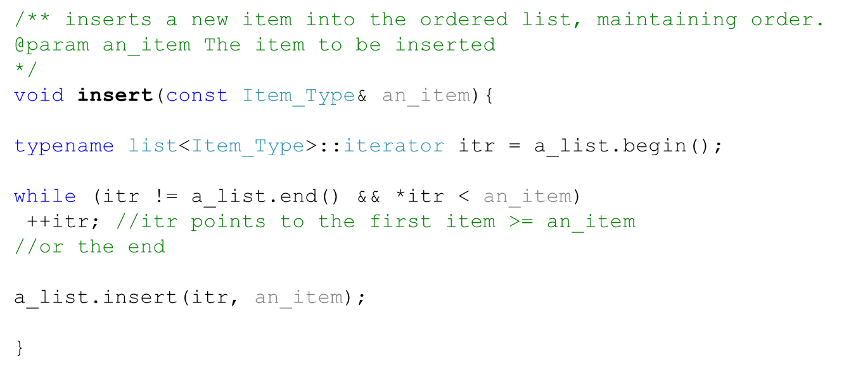
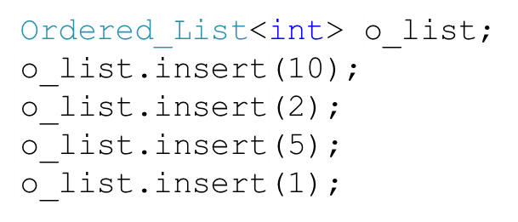
Ordered Lists (2)
10
10
1
2
5

Slide 47
Applications of Linked Lists
Can be used to build other data structures (stacks, queues)
Can be used in web browsers (to remember the addresses you visited)
Circular lists can represent objects that are circular in nature (e.g. polygons)

